Slide 1
Architecture Evaluation
张严辞

Slide 2
Outline
Overview
Architecture tradeoff analysis method
Cost benefit analysis method

Slide 3
Outline
Overview
Architecture tradeoff analysis method
Cost benefit analysis method

Slide 4
Purpose
How to evaluate architecture to make sure it is a right one?
Tend to increase quality, control cost, and decrease budget risk
Basic questions to be answered
Why
When
Benefits
Techniques
…

Slide 5
Why & When
Architecture indicates important properties of system even before being built
Great economic values
Provide a low-cost risk mitigation capability
Always cost-effective to evaluate software quality as early as possible
Can be carried out at many points during system’s life cycle
An architecture evaluation should be a standard part of every architecture-based development methodology

Slide 6
Benefits
Financial: 10% reduction in project costs
Forced preparation for review: reviewees must document system’s architecture that is understandable to all developers
Captured rationale: documented design rationale is important later in software life cycle
Early detection of problems: the earlier in the life cycle that problems are detected, the cheaper it is to fix them
Validation of requirements: a much clearer understanding of the requirements and prioritization
Improved architectures

Slide 7
Challenges
How to determine whether a software architecture is suitable without having to build the system first?
Difficult to understand a large architecture in a limited amount of time
Difficult to make connection between business goals and technical decisions
Difficult to manage evaluation process to acquire different perspectives from stakeholders

Slide 8
Outline
Overview
Architecture tradeoff analysis method
Cost benefit analysis method

Slide 9
ATAM Purpose
Assess consequence of architectural decisions in light of quality attribute requirements
Can be done early in software development life cycle
Can be done relatively inexpensively and quickly
Not precisely predict quality attribute behavior
A risk identification activity, recording risks, sensitivity points and tradeoff points

Slide 10
Potential Future Concern 1/2
Risks
Architecturally important unmade decisions
Decisions made but with not fully understood consequences
Sensitivity points
Architectural decisions that have a marked effect on one quality attribute
Tradeoff points
A parameter is host to more than one sensitivity point where the measureable quality attributes are affected differently by changing that parameter

Slide 11
Potential Future Concern 2/2
Example
Adopting a backup database is clearly an architectural decision as it affects reliability (positively)
Thus it is a sensitivity point with respect to reliability
However, keeping the backup current consumes system resources and so affects performance negatively
Hence, it is a tradeoff point between reliability and performance
Whether this decision is a risk or a nonrisk depends on whether its performance cost is excessive

Slide 12
Participants
The evaluation team
Competent and unbiased outsider
Consists of 3~5 people with different roles
Project decision makers
Empowered to speak for the development project
Include project manager, identifiable customer, architect
Architecture stakeholders
Articulate the specific quality attribute goals should be satisfied
Include developers, testers, integrators, maintainers…

Slide 13
Outputs
A concise presentation of the architecture
Articulation of the business goals
Quality requirements in terms of a collection of scenarios
Mapping of architectural decisions to quality requirements
A set of identified sensitivity and tradeoff points
A set of risks and nonrisks
A set of risk themes

Slide 14
Phases: Overview
Phase 0: Partnership and preparation (several weeks)
Phase 1: Evaluation (1 day followed by a hiatus of 2~3 weeks)
Phase 2: Evaluation continued (2 days)
Phase 3: Follow-up (1 week)

Slide 15
Steps of Evaluation
Analysis phases (phase 1 and 2) consist of nine steps
Phase 1: steps 1~6
Phase 2: steps 7~9
Steps are nominally carried out sequential order, but dynamic modifications are allowed

Slide 16
Steps of Evaluation Phase 1
Present ATAM
Present business drivers
Present architecture
Identify architectural approaches
Generate quality attribute utility tree
Analyze architectural approaches

Slide 17
S-1: Present ATAM
Evaluation team leader presents ATAM
ATAM steps in brief
Techniques used for elicitation and analysis
Outputs from evaluation

Slide 18
S-2: Present Business Goals
Project manager presents system overview from a business perspective
System’s most important functions
Any relevant technical, managerial, economic, or political constraints
Business goals and context
The major stakeholders
The architectural drivers (the major quality attribute goals)

Slide 19
S-3: Present Architecture
Lead architect describe architecture at an appropriate level of details in 60 minutes
Technical constraints such as OS, hardware, middleware…
Architectural approaches used to meet requirements
At this time evaluation team begins its initial probing of architectural approaches

Slide 20
Case Study: ATC System
Air Traffic Control (ATC) is among most demanding of all software application
Hard real time: timing deadlines must be met absolutely
Safety critical: human lives may be lost if it does not perform correctly
Highly distributed: requiring dozens of controllers to work cooperatively to guide aircraft through airways system

Slide 21
Case Study: ATC System
What are the most important quality attributes for ATC?
Ultrahigh availability: system is absolutely prohibited from being inoperative for longer than very short periods
Targeted at 0.99999, meaning that the system should be unavailable for less than 5 minutes a year
High performance: system has to be able to process large numbers of aircraft—as many as 2,440—without "losing" any of them

Slide 22
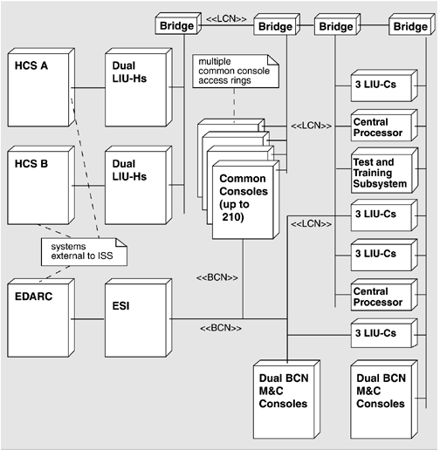
Case Study: ATC System
Distributed system, consisting of a number of elements connected by local area networks
Two HCSs (Host Computer System): one primary and the other ready to take over if primary one fails
Common consoles display aircraft information

Slide 23
Case Study: ATC System
LCN is primary network
HCS connects to LCN via dual LIU-Hs, which act as a fault-tolerant redundant pair
LCN is composed of four parallel token ring networks for redundancy and for balancing overall loading
BCN is used as a backup network for LCN

Slide 24
Case Study: ATC System
Both LCN and BSN have associated Monitor-and-Control (M&C) consoles to display state of system
Test and Training Subsystem provides capability to test new hardware/software and to train users without interfering with ATC mission

Slide 25
S-4: Identify Arch. Approaches
Architectural approaches are identified by architect, and captured by evaluation team
Evaluation team studies architecture documentation and catalogs evident patterns and approaches

Slide 26
S-5: Generate QAUT
Identify, prioritize and refine system’s most important quality attribute goals
Crucial step to guide the remainder of analysis
Evaluation team, architecture team, manager, customer representatives work together
Build utility tree to guide attention of all stakeholders on the most critical architectural design

Slide 27
Utility Tree
A top-down mechanism for translating business drivers into concrete quality attribute scenarios
Provides a prioritized list of scenarios serving as plan for remainder of ATAM
Concretizes quality attribute requirements, forcing evaluation team and customer to define requirements very precisely

Slide 28
Case Study
Building an e-commerce system
Business goals
Security is central to the success of the system since ensuring the privacy of our customers’ data is of utmost importance
Modifiability is central to the success of system since we need to be able to respond quickly to a rapidly evolving and very competitive marketplace
…

Slide 29
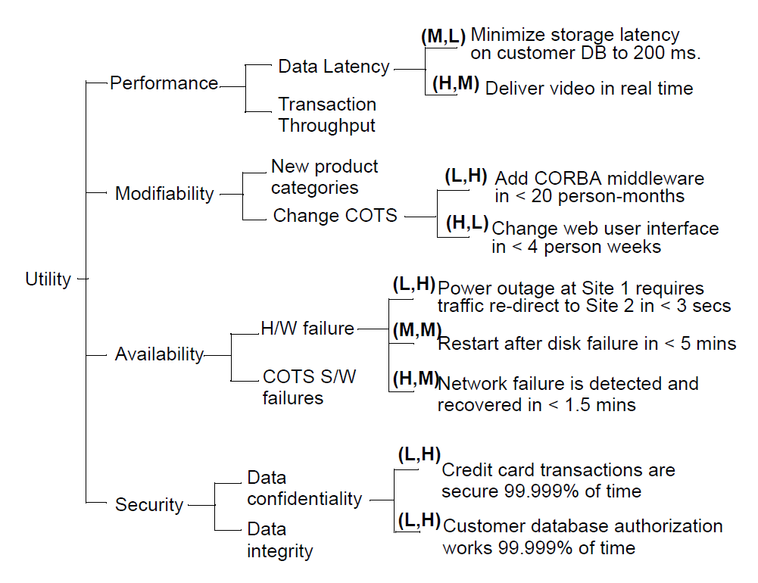
Case Study
Priority pair (business importance, technical risk)
Quality sub-factors
Specific enough to be prioritized
Expression of overall “goodness” of system
High-level quality attributes

Slide 30
Case Study
Refining utility tree may lead to interesting and unexpected results
Creating utility tree guides key stakeholders in considering, explicitly stating, and prioritizing all of current and future driving forces on architecture

Slide 31
S-6: Analyze Arch. Approaches
Evaluation team examines highest ranked scenarios
Convince evaluation team that the approach is appropriate to meet attribute-specific requirements
Output
A list of architectural approaches associating with questions and architect’s response

Slide 32
Hiatus & Start Phase 2
One or two weeks hiatus between phase 1 and 2
Evaluation team summarize information collected in phase 1
Continue interact with architect
Phase 2 involves more stakeholders
Evaluation leader recaps results of steps 2 through 6
Shares current lists of risks, nonrisks, sensitivity points and tradeoff points

Slide 33
Steps of Evaluation Phase 2
Brainstorm and prioritize scenarios
Analyze architectural approaches
Present results

Slide 34
S-7: Brainstorm
Taking pulse of large stakeholder community
Bring up scenarios that are meaningful with respect to stakeholders’ individual roles
Encourage using unanalyzed utility tree scenarios
Prioritize collected scenarios by voting
Only consider highly ranked scenarios

Slide 35
S-8: Analyze Arch. Approaches
Architect explains how relevant architectural decisions contribute to realizing highest ranked scenarios
Similar activities as in step 6

Slide 36
S-9: Present Results
Outputs
The architectural approaches documented
The set of scenarios and their prioritization from the brainstorming
The utility tree
The risks discovered
The non-risks documented
The sensitivity points and tradeoff points found

Slide 37
Outline
Overview
Architecture tradeoff analysis method
Cost benefit analysis method

Slide 38
Overview 1/3
ATAM studies relationships between architectural decisions and quality attributes
Important fact: resources for building and maintaining a system are finite
One crucial consideration is missed: What are economic implications of an architectural decision?
Cost: build, maintain and upgrade system
Benefit:
Need economic models taking into account costs, benefits, risks

Slide 39
Overview 2/3
Enable reasoned selection from among competing alternatives by their costs and benefits
Example:
Option 1: using redundant hardware to achieve availability
Option 2: checkpointing to a disk file
Aid elicitation and documentation of value for cost (VFC)

Slide 40
Overview 3/3
Input
A collection of quality attribute scenarios generated from requirements elicitation, architectural evaluation…
Architectural strategies
Output
Calculate VFC of an architectural strategy by combining its overall utility and cost
Utility: benefit gained by some architectural strategies
Each strategy provides a specific level of utility

Slide 41
Utility-Response Curves 1/2
Example
Is “99.99 percent available” almost as good as “99.999 percent available”?
If so, it might be a preferred option
Stimulus-response pair provides some comparable utility
Utility-response curve shows utility as a function of response

Slide 42
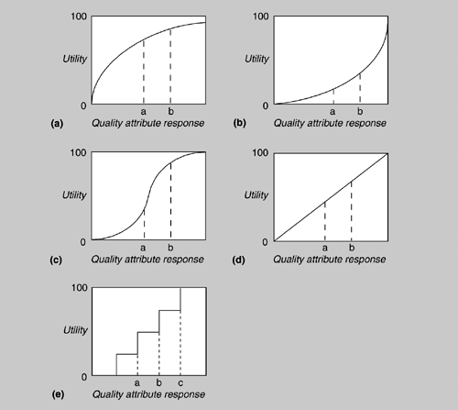
Utility-Response Curves 2/2

Slide 43
Weighting Scenarios
Different scenarios have different importance to stakeholders
Make no sense to spend a great deal of effort optimizing a particular scenario with little importance

Slide 44
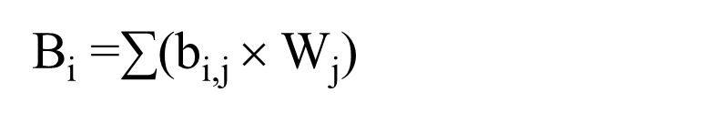
Determining Benefit
Architectural strategy often has negative effect on other quality attribute
Benefit of applying an architectural strategy should consider its benefit to all relevant quality attributes
Overall benefit is sum of utilities, weighted by importance of scenario
where b_{i,j} = U_{expected} - U_{current}

Slide 45
Calculating VFC
VFC is ratio of the total benefit to cost
VFC_{i} = B_{i} / C_{i}
Cost is estimated by some model appreciate for current system

Slide 46
Theory Into Practice: CBAM
Most often been applied when upgrading an existing system or choosing competing architectural strategies
Challenges
How to determine utility curve?
How to weight scenario?
How to determine cost?

Slide 47
Utility Curve Determination
Determine some special points
Best-case (above which stakeholders foresee no further utility) = 100
Worst-case (minimum threshold above which system must perform) = 0
Current
Desired
Other utility values for various alternative strategies are derived using best-case and worst-case values as reference point
Example: 90% of maximum utility = 90

Slide 48
Weighting Determination
Many possible schemes to determine scenarios weights
The highest priority scenario of N Scenarios is given weight of 1, the next highest is given a weight of (N-1)/N, and so on
Voting schemes: each stakeholder prioritize scenarios from 1 to N, and final weight of a scenario is sum of received priorities

Slide 49
Cost Determination
Very few cost models for architectural strategies
Estimate cost based on previous experience with similar architecture, or intuition of senior architects
Often turn to estimation techniques

Slide 50
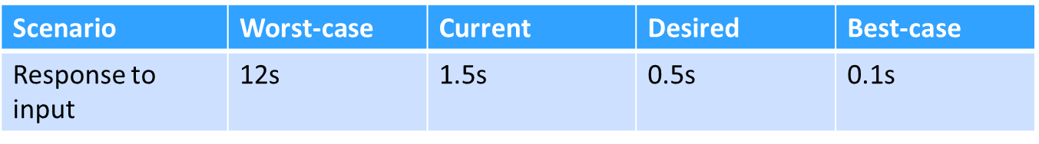
CBAM Steps 1/4
Collate scenarios: Rank scenarios and choose top one-third for further study
Refine scenarios: Elicit quality attribute response level of worst-case, best-case, current and desired for each scenario
Prioritize scenarios
Prioritize scenarios on desired response value
Choose top half for further study
Assign weights to scenarios which will be used in VFC computation

Slide 51
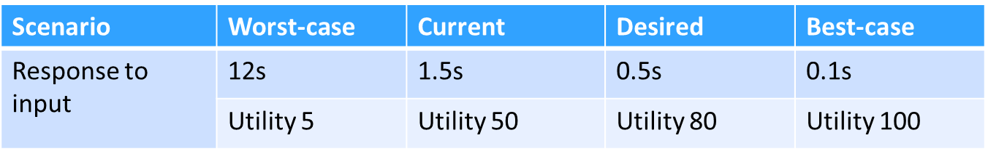
CBAM Steps 2/4
Assign utilities: determine utility for each quality attribute level from step 3
Determine quality attribute response levels of architectural strategies

Slide 52
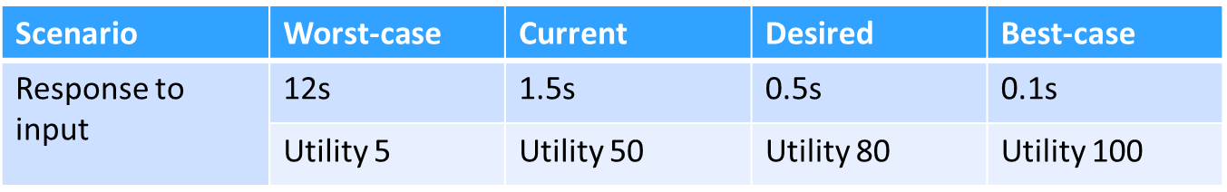
CBAM Steps 3/4
Determine utility by interpolation
Example: A new architectural strategy with response time of 0.7s, its utility value should be 74 which is computed from linear interpolation
Calculate total benefit obtained from an architectural strategy

Slide 53
CBAM Steps 4/4
Choose architectural strategies based on VFC
Confirm results with intuition

